Slide 1
Early Learning Facilities
Site Assessments & Financing Strategy Phase 2
Presentation to First 5 SMC Commission
Prepared for
San Mateo County Human Services Agency
First 5 San Mateo County
Child Care Partnership Council of San Mateo County
Prepared by
Brion Economics Team
February 27, 2017
Notes:
Questions:

Slide 2
Phase 1 Tasks: ELF Needs - Complete
Evaluate demand for child care, ages 0 to 4
Evaluate existing supply
Estimate shortage by city and countywide
Estimate future need over 10 years
Provide Need Profiles for each city or county area
Survey center-based providers and county stakeholders

Slide 3
Phase 2 Tasks: ELF Sites, Costs, & Strategy
Follow up with Provider & Stakeholder sites leads
Identify potential child care sites for further research
Conduct assessments of top 7 candidate expansion sites
Develop Child Care Capital Improvement Plan (CIP)
Evaluate financing mechanisms, e.g., developer fees

Slide 4
Potential Child Care Site Assessments
Sites first evaluated based on unmet demand by location
Surveys generated 49 potential site leads
19 of 49 showed potential and were evaluated by Study Committee and Consultants
Consultants contacted each site lead to gather more information
7 of these 19 were researched further and were the focus of the site assessments

Slide 5
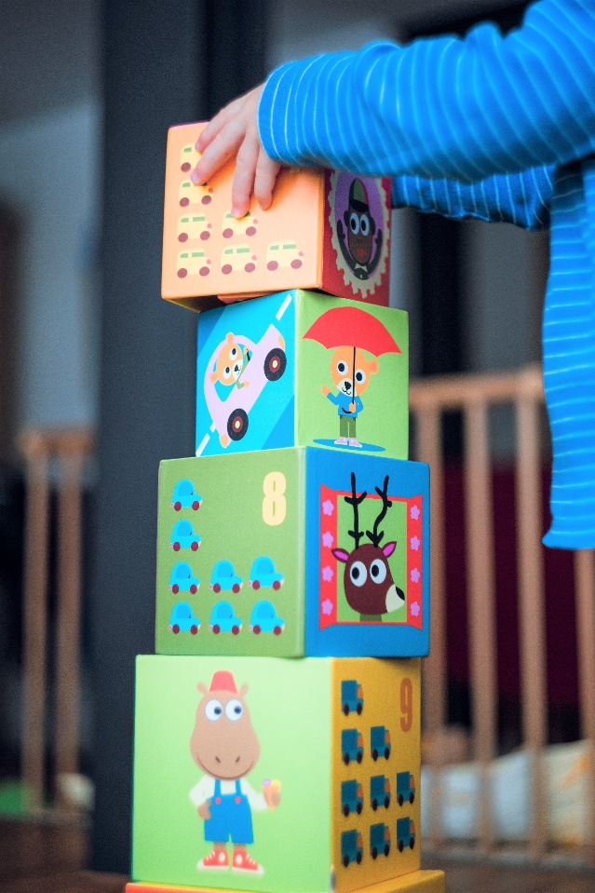
Site Assessment Criteria
-
Size of site and building space
No. of children accommodated
Cost or availability of site
Ownership & support of owner
Zoning and other planning considerations, e.g., parking
Options for outdoor space

Slide 6
7 Assessment Sites
Daniel Webster Elementary School, Daly City
Fair Oaks Center at St. Anthony’s Church, Menlo Park
Midway Village, Daly City
First Presbyterian Church, San Mateo
Cañada College, Redwood City
Various Sites, Cabrillo Unified School District
Oddstad School Site, Pacifica
Sites 6 and 7 were eliminated upon further research

Slide 7
Site Assessment Findings
Cost and Funding
Building Codes
Zoning and Permits
Licensing and Outdoor Space
Multiple Parties and Approvals Involved
Lack of Available Land
School Districts and Faith Based Organizations Best
Strong Interest and High Need
Many Challenges, including neighborhood opposition

Slide 8
Child Care Capital Improvement Plan*
Costs based on 13 recent projects, adjusted for inflation
Costs Estimates assume:
40% - New building construction – $43,200 per space
20% - New or existing commercial space – $53,800 per space
15% - Expanding existing centers – $37,000 per space
20% - Portable buildings – $25,400 per space
5% - Employer-based centers – $41,000 per space
Overall average Cost: $40,717 per ELF space
*includes indoor & outdoor space costs

Slide 9
How Many Children are Served with 1 New Space?
Average cost: $40,717 per space
30 year life per space
Attendance - 4 years per child
7.5 children served over 30 years
Average cost per child: $5,429

Slide 10
Existing & Future ELF Space Unmet Demand
Existing Unmet Demand as of 2015
7,802 spaces
$327.2 million*
Future Growth in Demand – 2015 to 2025
2,414 spaces
$101.2 million*
* includes 3% admin. cost; excludes land costs

Slide 11
Total & Average Costs & Spaces
Total Countywide Capital Costs: $428.4 million
Total ELF Spaces Needed: 10,216
Spread over 10 Years:
145 infant spaces per year
876 preschool spaces year
1,022 total ELF spaces per year
10 year average annual cost: $42.8 million

Slide 12
Study Qualifications & Assumptions
Assumes all public financing
Private sector will meet some need
Some projects will cost less
Use of “pay-as-you-go” methods reduce costs
DAs, CPBs, Low Interest Loans, Grants & Foundation funding will reduce costs
Cities & County can reduce permit costs & streamline process
Land costs excluded
Cost estimates based on recent projects

Slide 13
Existing Child Care Shortfall Costs - $318 m*
* excluding 3% admin. cost; excludes land costs

Slide 14
Future 2015 to 2025 ELF Costs - $98.3 m*
* excluding 3% admin. cost; excludes land costs

Slide 15
Recommended Financing Mechanisms
Sales Tax Add-Ons
Parcel Taxes
Developer Impact Fees
Employer-Based Care
Grants and Foundations
State Child Care Facilities Revolving Fund
Community Benefits Programs (CBPs)
Development Agreements (DAs)

Slide 16
Countywide Sales Tax
Current Retail Taxable Sales in 2014*: $10.3 billion
Additional Child Care Sales Tax Rate: 0.25%
Net Annual Proceeds: $25.4 million
Gross Bond Proceeds: $292.2 million
Average Annual Cost per Household: $96
% of Avg. Annual Tax Paid: 2.8%
*most recent data available

Slide 17
Countywide Parcel Tax
Total Residential Parcels: 203,000
Current Res. Assessed Value: $133.6 billion
25% of Need: $81.8 million
Gross Bond Proceeds: $97.4 million
Average Annual Parcel Tax: $42
% of Res. AV: 0.07%

Slide 18
Residential Developer Impact Fees
Developer Impact Fees can only Fund Future Demand
Total Cost: $101.2 million
2015 to 2025 Population Growth: 60,200
Estimated New Residential Units: 21,733
New Child Care Spaces Needed: 2,414
Potential Impact Fee per unit: $4,658

Slide 19
Recommendations
Increase Advocacy
Engage Cities
Evaluate Countywide Funding Mechanism
Encourage Large Employers
Partner with School Districts & Faith-Based Orgs.
Leverage New Development
Reduce Barriers – Update Zoning & Permit Process

Slide 20
Questions and Comments?
For more information and documents see:
www.smcoe.org/elfnar
Contact Joanne Brion at joanne@brionecon.com

